Slide 1
Cross Site Scripting
Domain: vulnweb.com
Sub Domain: testasp.vulweb.com
Url: http://testasp.vulnweb.com/
Summary:
Performing an XXS (Cross-Site Scripting) attack on testasp.vulweb.com aims to uncover vulnerabilities. By injecting malicious scripts into web pages, attackers can exploit the website's lack of input validation. This allows them to execute scripts in users' browsers, potentially compromising sensitive data or hijacking sessions. Detecting and fixing these vulnerabilities is crucial to safeguarding against cyber threats.

Slide 2
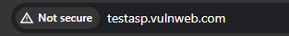
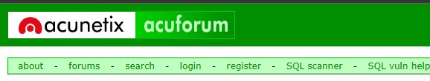
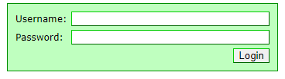
Steps to reproduce:
To reproduce this, an attacker has to gone through this steps:
Step 1: visit http://testasp.vulnweb.com/
Step 2: On the top you will find login option
Step 3: Click on it and you will be promoted with the login box

Slide 3
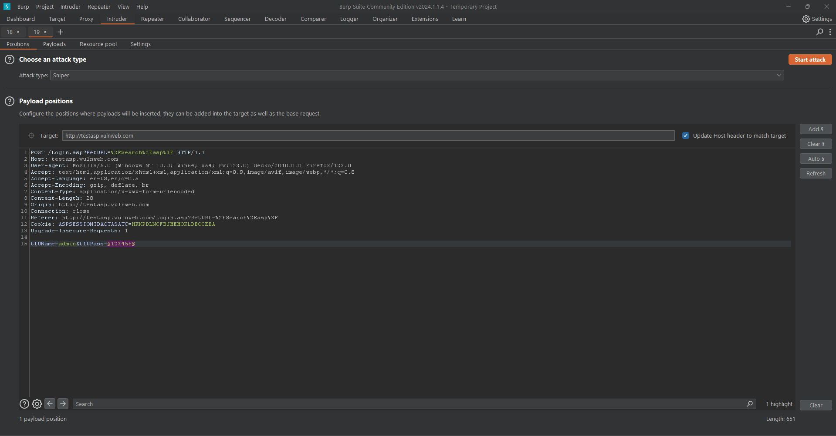
Step 4: You can intercept the request in Burp Suite

Slide 4
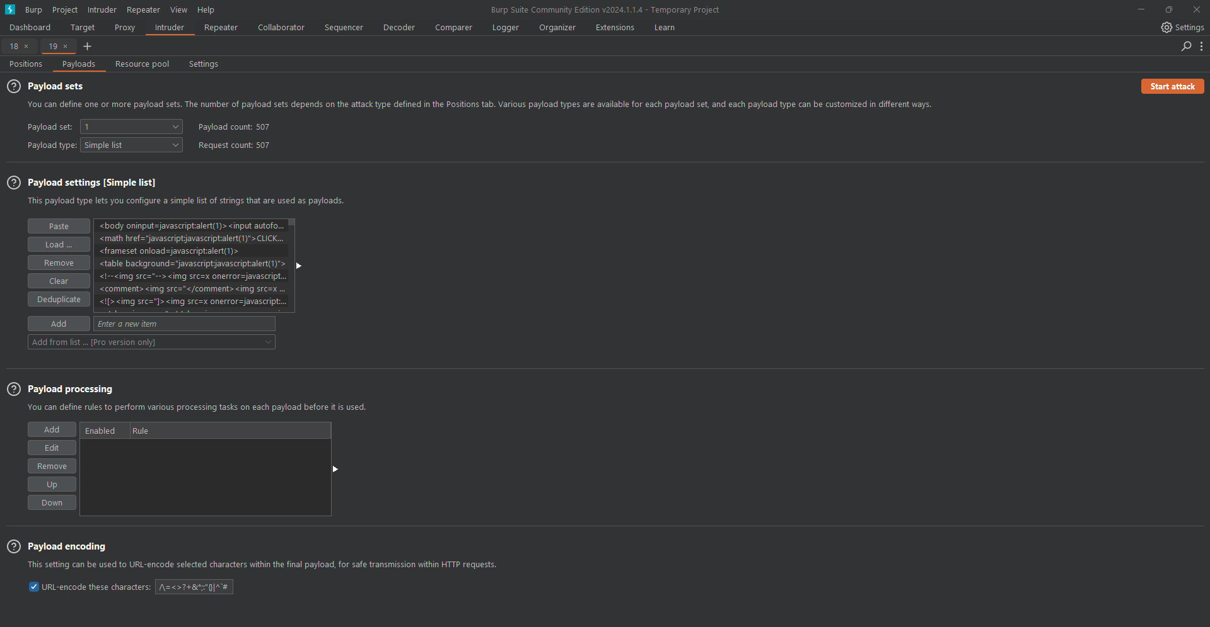
Steps 5: Now you can find different payloads for xss
Step 6: Send the request to intruder and paste all the payloads

Slide 5
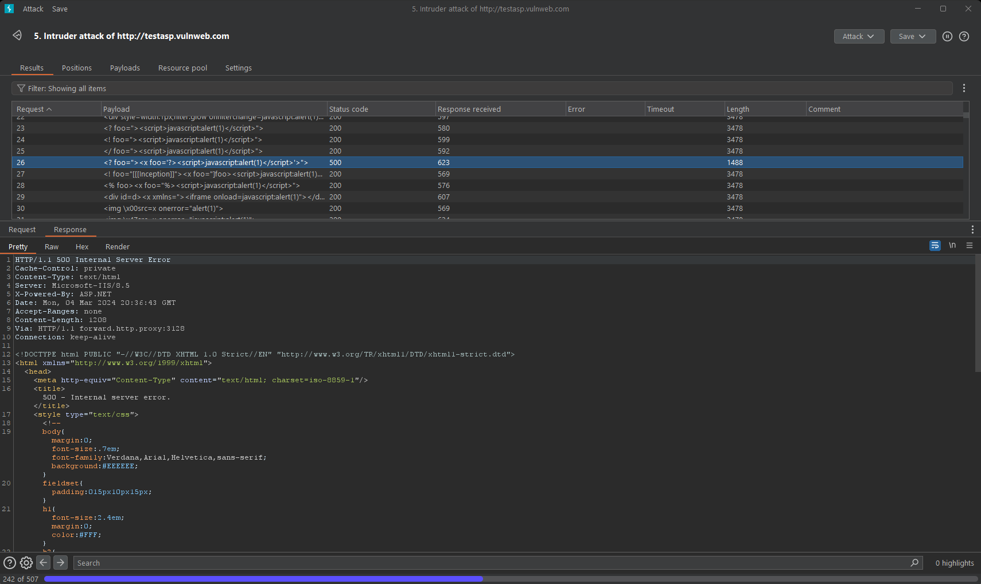
Step 7: Try to find a successful payload for xss
Step 8: Payload Result

Slide 6
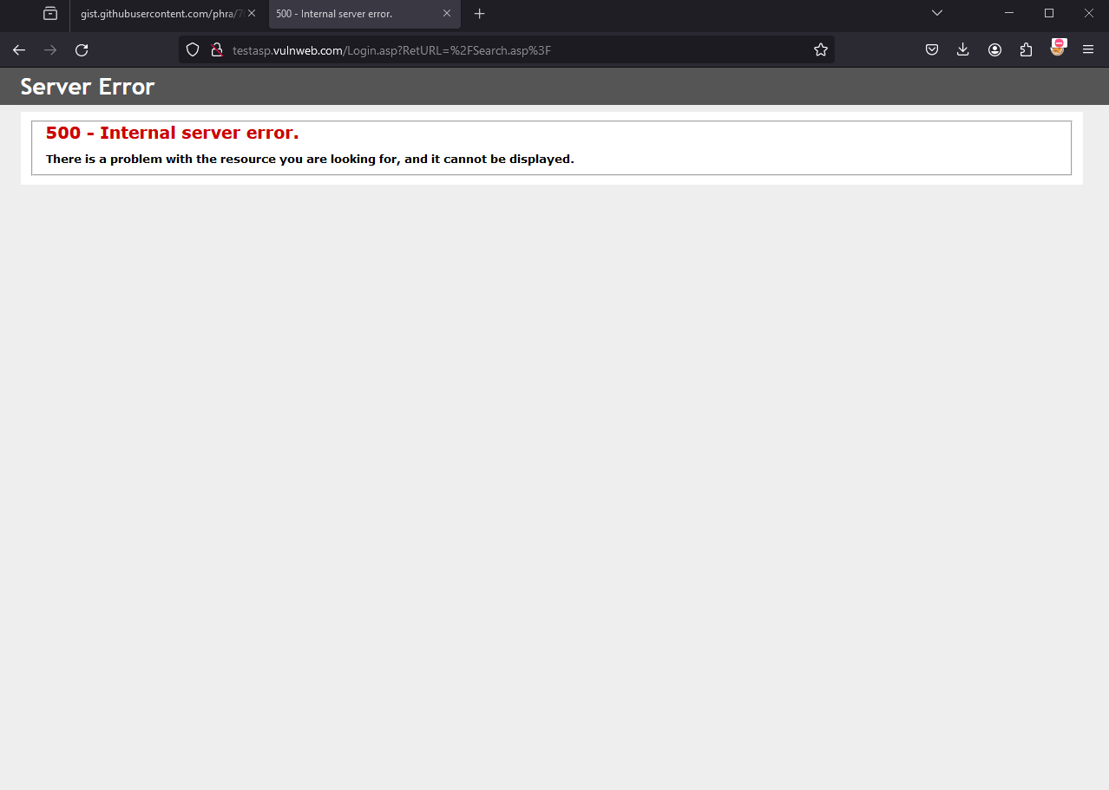
Step 9: Web Result

Slide 7
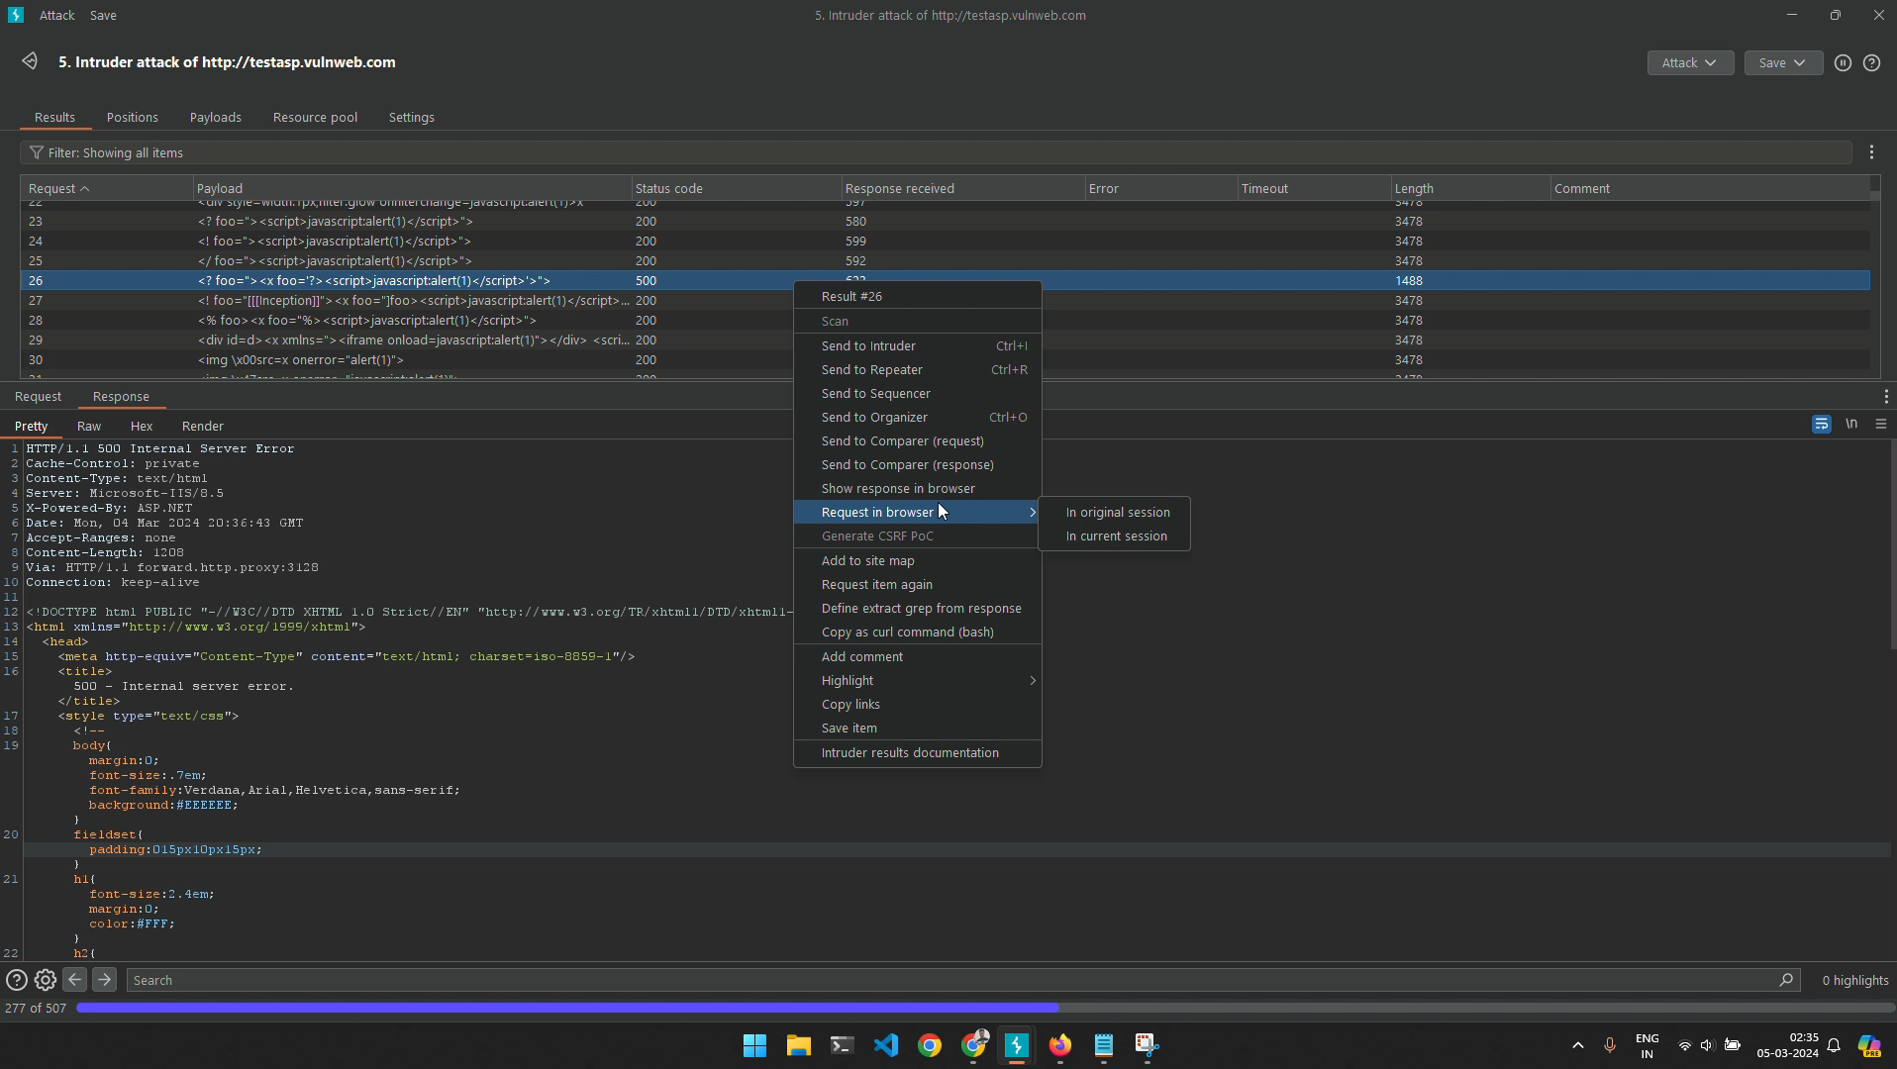
Video Demonstration:

Slide 8
Impact:
Exploiting the Cross-Site Scripting (XXS) vulnerability on testasp.vulweb.com enables attackers to inject malicious scripts into web pages.
Attackers can compromise user accounts, hijack sessions, and steal sensitive data like login credentials.
Unauthorized actions can be performed on behalf of users, undermining trust in the website.
Financial loss, reputational damage, and legal consequences may follow due to compromised security.
Addressing and patching this vulnerability is crucial to protect users' data, maintain trust, and prevent potential financial and legal liabilities for the website owner.

